Slide 1


Ccna quiz discord Bot presentation
BTS CLOUD COMPTIONG (PYTWO)
Aristide KATAGARUKA
May 3, 2025

Slide 2
Problem Statement
BTS students score <80% on CCNA 1, 2, 3 tests
Challenges:
Unstructured revision
Complex networking concepts
Limited MCQ practice
Lack of personalized feedback

Slide 3
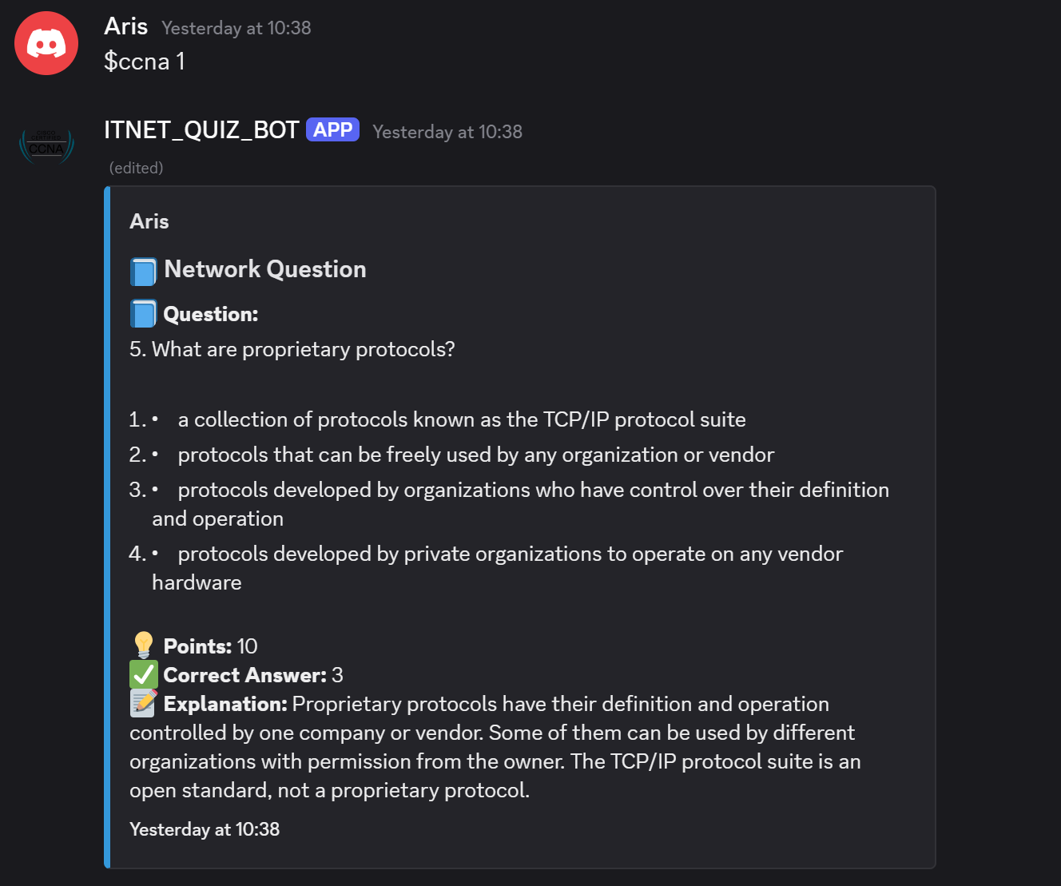
BTS students score <80% on CCNA 1, 2, 3 tests
Challenges:
Unstructured revision
Complex networking concepts
Limited MCQ practice
Lack of personalized feedback
CCNA Quiz Bot: Python-based Discord bot
Objectives:
Structured quizzes
Automated flashcards, reminders
Leaderboard gamification
Educational resources

Slide 4
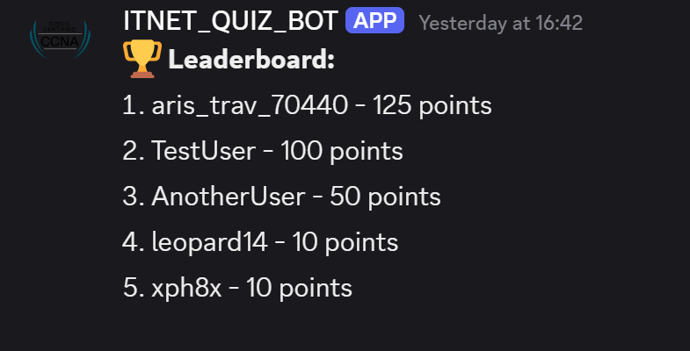
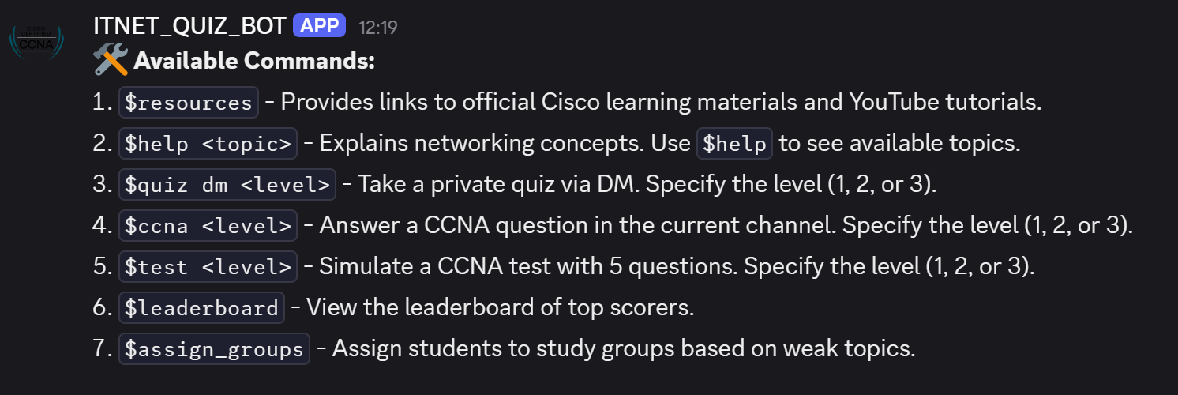
Key Features
Quizzes: $ccna, $quiz dm, $test
Leaderboard: $leaderboard
Resources: $resources
Explanations: $help <topic>
Study Sessions: Pomodoro flashcards
Daily Quizzes & Reminders
Study Groups: $assign_groups

Slide 5
Implementation
Tech Stack:
Python, discord.py, Django, PIL
Heroku: polar-forest-95759, 1 dyno, $7/month
API for questions
Development:
Apr 22–Apr 28, 2025
Deployed via Heroku Git

Slide 6
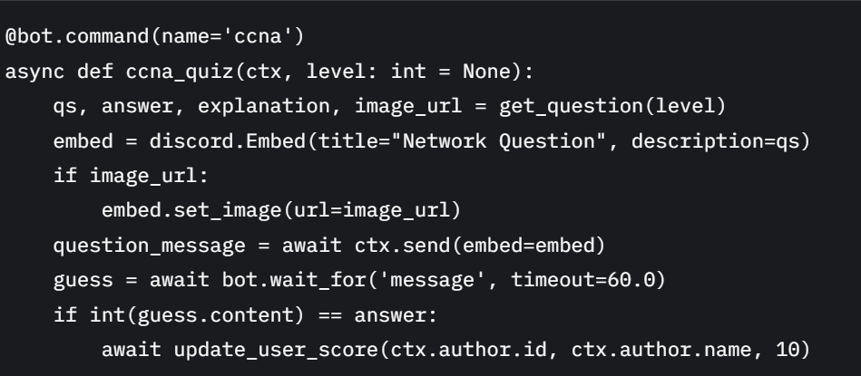
Code Showcase
Core logic: ccna_quiz function
Features:
API question fetch
Discord embeds
Async score updates

Slide 7
Demo
Live Demo:
$ccna 1 or 2 or 3: Quiz with embed, explanation
$leaderboard: Top scorers
Expected Output:
Interactive quiz response
Leaderboard rankings

Slide 8
Testing & Feedback
Testing:
Unit, functional, integration
2+ students, multiple scenarios
Feedback:
Positive: Easy to use, engaging, comprehensive
Constructive: Customization, gamification needed
Negative: Could not see the leaderboard (now fixed)

Slide 9
Challenges
API Integration: Handled timeouts
Concurrent Users: Async tasks
Permissions: Adjusted restrictions
Error Handling: Clear messages
Time Management: Prioritized features

Slide 10
Conclusion
Achievements:
Enhanced CCNA preparation
High user engagement
Practical Python application
Future:
Custom quizzes, badges, multi-language

Slide 11
Thank you! Any questions?

